Slide 1
Nim Game
by Lilian Ma & Sunnia Ye

Slide 2
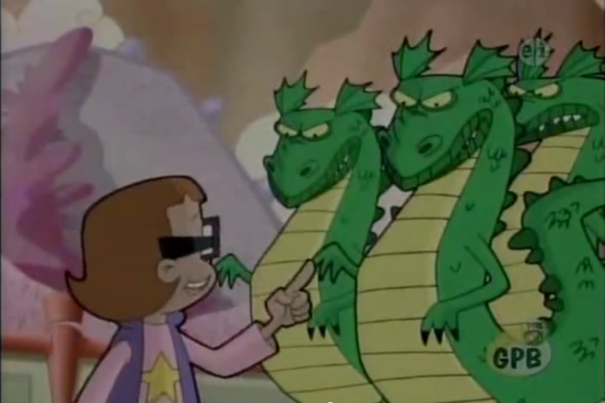
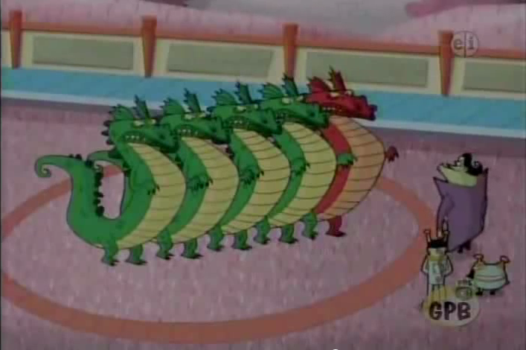
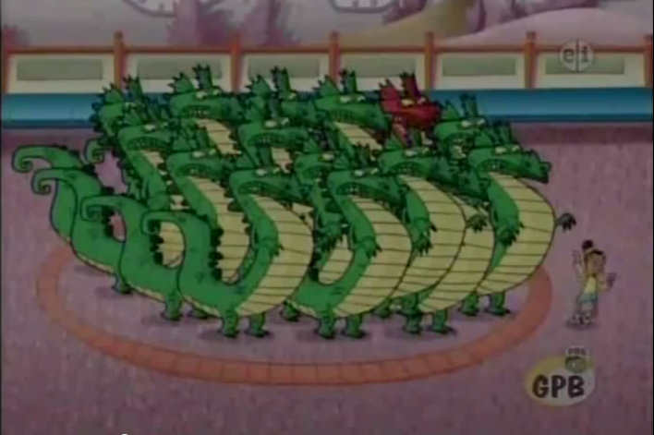
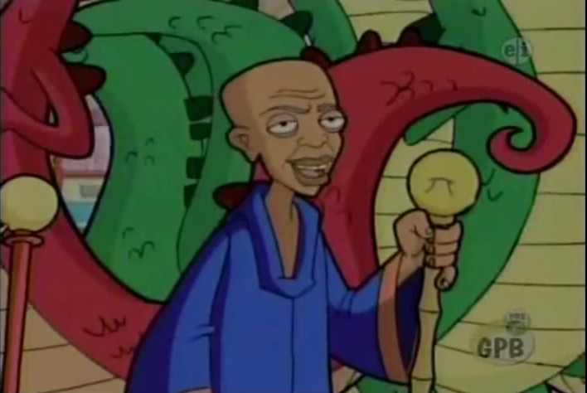
Have any of you ever watched CyberChase?

Slide 3

Nims
Pile of 99 coins
98 copper
1 gold (at the bottom)
Objective: get the gold coin
Two Players: You & Computer
you go first
Players can take 1-4 coins each turn

Slide 4
How does it work?

Slide 5
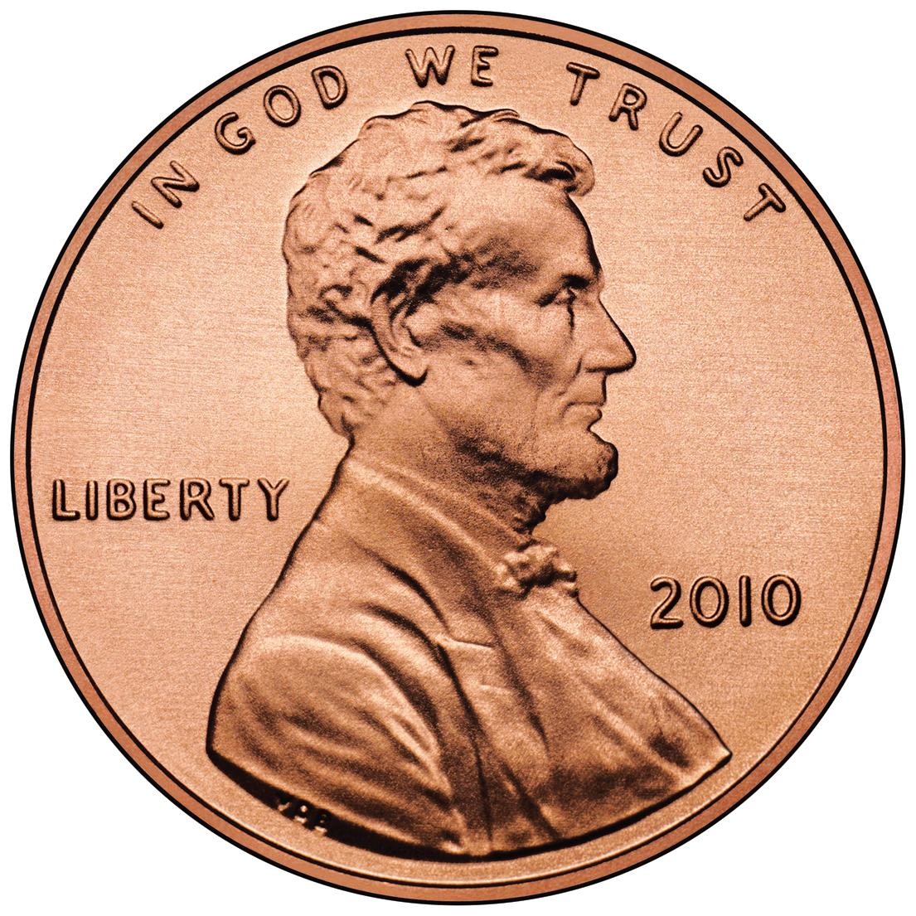
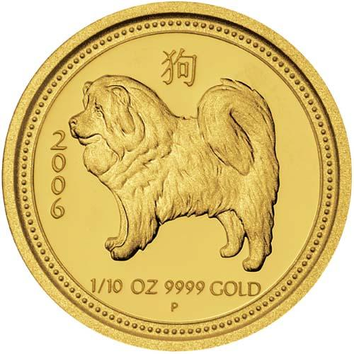
Say the stack has 5 coins, and it’s your turn. What do you do?
You can choose 1 - 4 coins. But no matter what you do, you won’t be able to get the last coin at this point in the game.

Slide 6
Now say the stack has 10 coins, and it’s your turn. What do you do?
You can take 1 - 4 coins. But your opponent can take as many coins as needed to force you to get stuck with 5 coins.

Slide 7
Strategy
By extension, getting stuck with a coin stack that is any multiple of 5 is bad.
The first player always wins (if she knows what she’s doing!)

Slide 8
Details

Slide 9
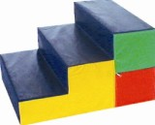
Our game
Three Levels:
Beginner
computer tries to let you win
Intermediate
computer chooses randomly
Advanced
computer tries to make you lose

Slide 10

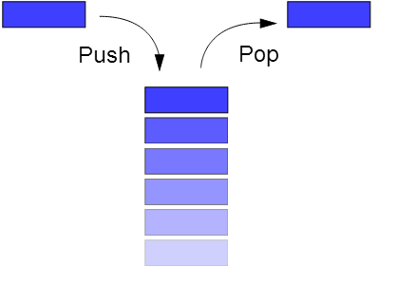
Data Structures
Stack (for coins)
Queue (for players)

Slide 11
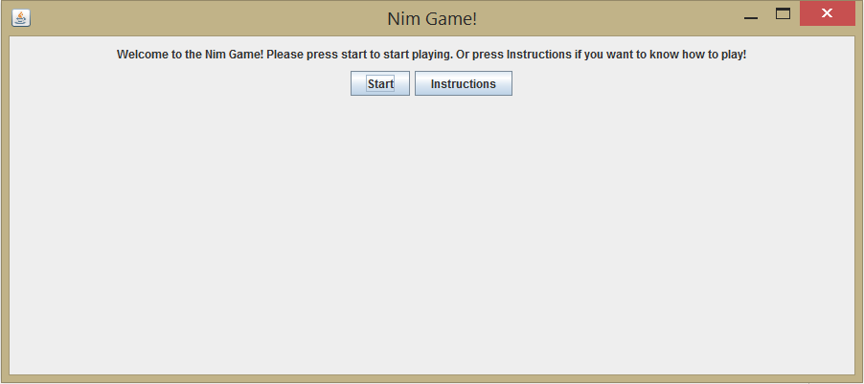

GUI

Slide 12
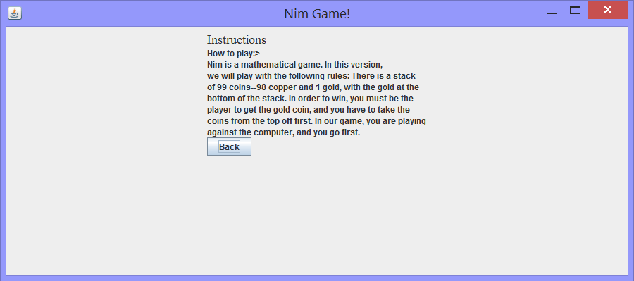
GUI

Slide 13
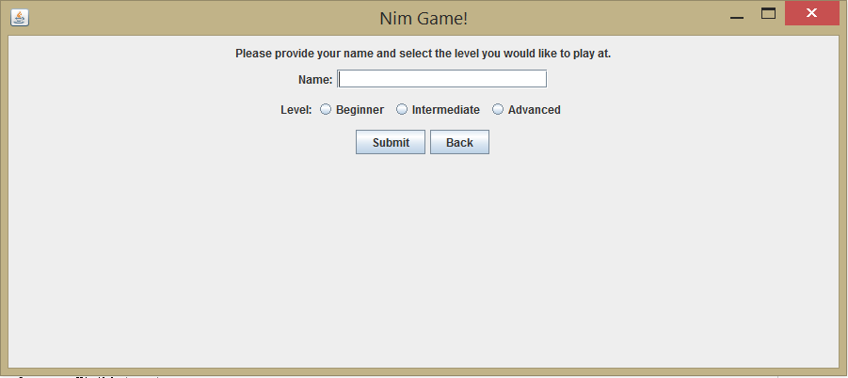
GUI

Slide 14
GUI
x 11
x 1
Total: 12
Dropdown Menu
Submit Button
Back Button

Slide 15

GUI
You won!
Play again? Yes | No

Slide 16

GUI
You lost!
Play again? Yes | No

Slide 17
Fin.
Questions/Comments?

